Slide 1
ADS Team 11
Text analytics

Slide 2
Word2Vec
Word2vec is a two-layer neural net that processes text.
Its input is a text corpus and its output is a set of vectors: feature vectors for words in that corpus.(a collection of written texts, especially the entire works of a particular author or a body of writing on a particular subject)
It turns text into a numerical form that deep nets can understand
Its applications extend to genes, code, likes, playlists, social media graphs and other verbal or symbolic series in which patterns may be discerned.

Slide 3
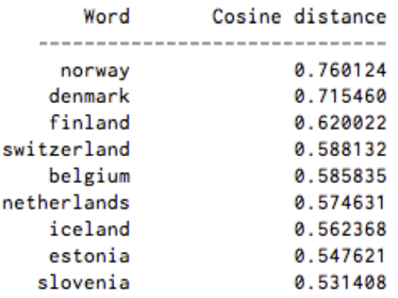
Word2Vec
The output of the Word2vec neural net is a vocabulary in which each item has a vector attached to it, which can be fed into a deep-learning net or simply queried to detect relationships between words
Measuring cosine similarity, no similarity is expressed as a 90 degree angle, while total similarity of 1 is a 0 degree angle, complete overlap;
list of words associated with “Sweden” using Word2vec

Slide 4
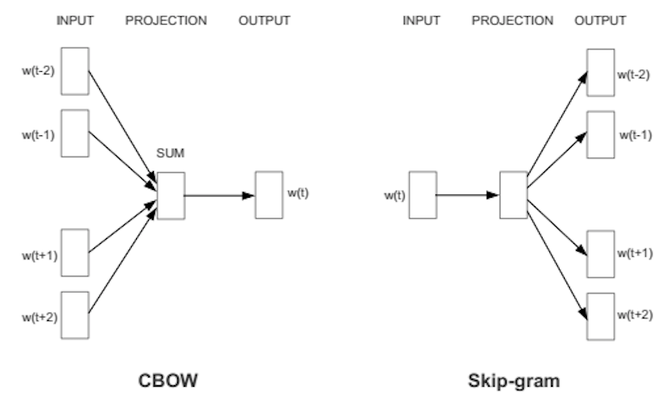
Word2Vector Prediction
Two Ways of word2vector prediction:
CBOW or continuous bag of words, (using context to predict a target word )
Skip-gram using a word to predict a target context

Slide 5
Neural Word Embeddings
natural language processing systems traditionally treat words as discrete atomic symbols, and therefore 'cat' may be represented as Id537 and 'dog' as Id143
natural language processing systems traditionally treat words as discrete atomic symbols, and therefore 'cat' may be represented as Id537 and 'dog' as Id143
Neural word embedding represents a word with numbers
natural language processing systems traditionally treat words as discrete atomic symbols, and therefore 'cat' may be represented as Id537 and 'dog' as Id143
http://localhost:8889/notebooks/word2vec.ipynb

Slide 6
AlchemyAPI service on IBM Bluemix
Two APIs from AlchemyAPI:
The Concept Tagging API provides a ranked list of relevant concepts in the document. This API uses rich-text analysis to identify concepts that aren't explicitly referenced. It also provides links so that users can quickly locate relevant data.
The Taxonomy API provides a nested categorization of concepts in the document. Users can quickly scan and focus in on their chosen topic.

Slide 8
Taxonomy API
https://www.ibm.com/developerworks/library/cc-analyze-notes-alchemyapi-trs-bluemix/

